Slide 1
Git and GitHub

Slide 2
Git
Git is free and open source software for distributed version control: tracking changes in any set of files, usually used for coordinating work among programmers collaboratively developing source code during software development.
Git was originally authored by Linus Torvalds in 2005
Git Download link : https://git-scm.com/downloads

Slide 3
GitHub
GitHub, Inc. is an Internet hosting service for software development and version control using Git. It provides the distributed version control of Git plus access control, bug tracking, software feature requests, task management, continuous integration, and wikis for every project.

Slide 4
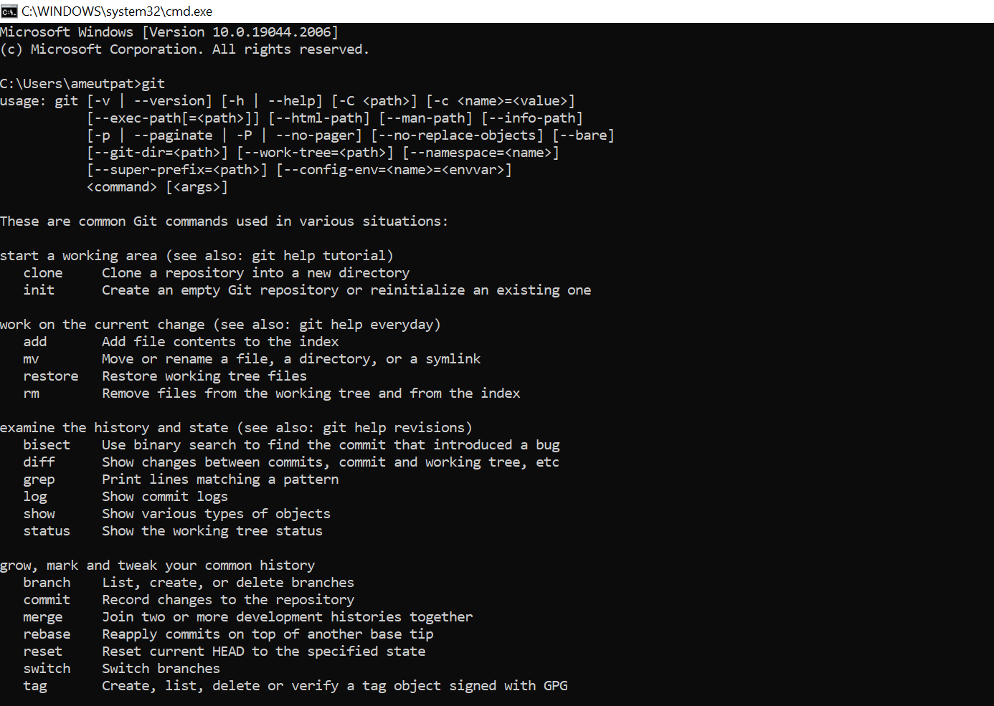
Type “git” on cmd after installation

Slide 5
git init
The git init command is the first command that you will run on Git. The git init command is used to create a new blank repository. It is used to make an existing project as a Git project. Several Git commands run inside the repository, but init command can be run outside of the repository.
The git init command creates a .git subdirectory in the current working directory. This newly created subdirectory contains all of the necessary metadata. These metadata can be categorized into objects, refs, and temp files. It also initializes a HEAD pointer for the master branch of the repository.

Slide 6
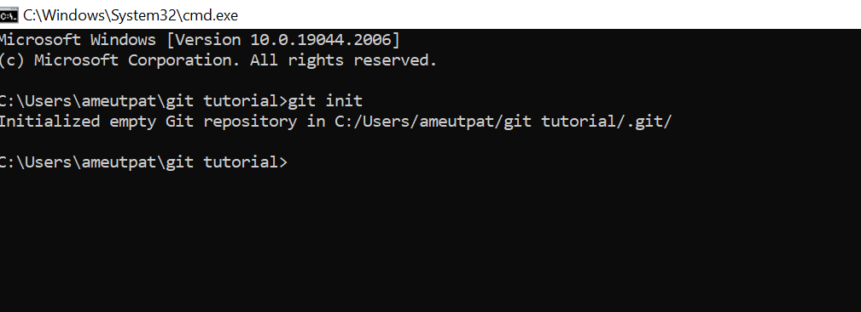
git init
The below command will initialize a .git repository on the desktop. Now we can create and add files on this repository for version control.

Slide 7
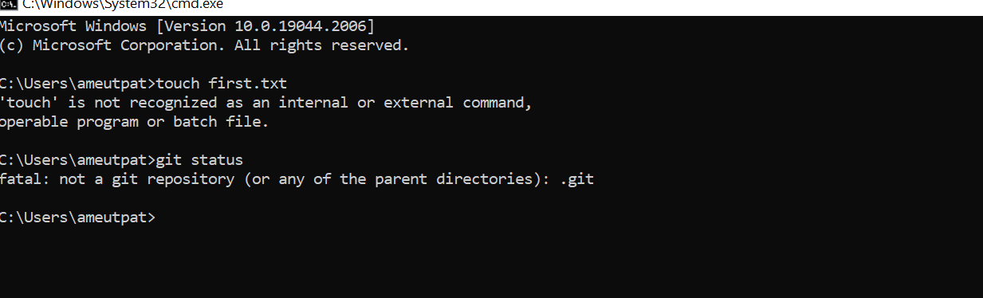
Tried to use some git commands in non git repository

Slide 8
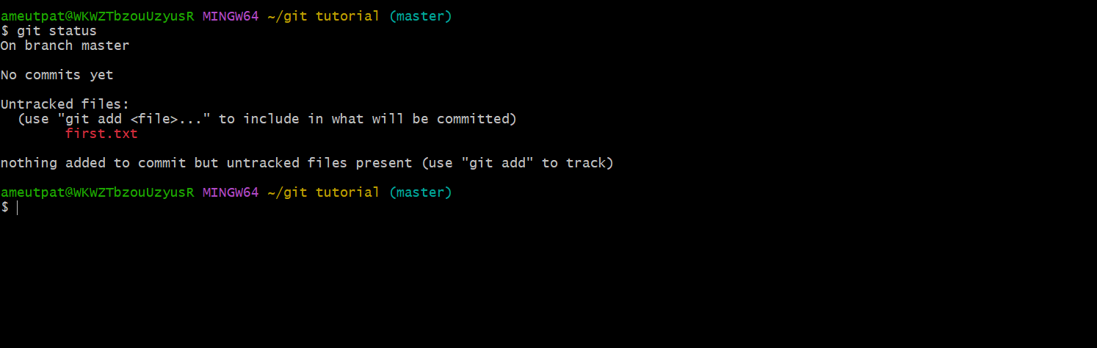
git status
We can list all the untracked files by git status command.

Slide 9
